Slide 1
2024 Elder Law Update
Presented by Attorney Matthew J. Parker

Slide 2
1984 Olympics

Slide 3
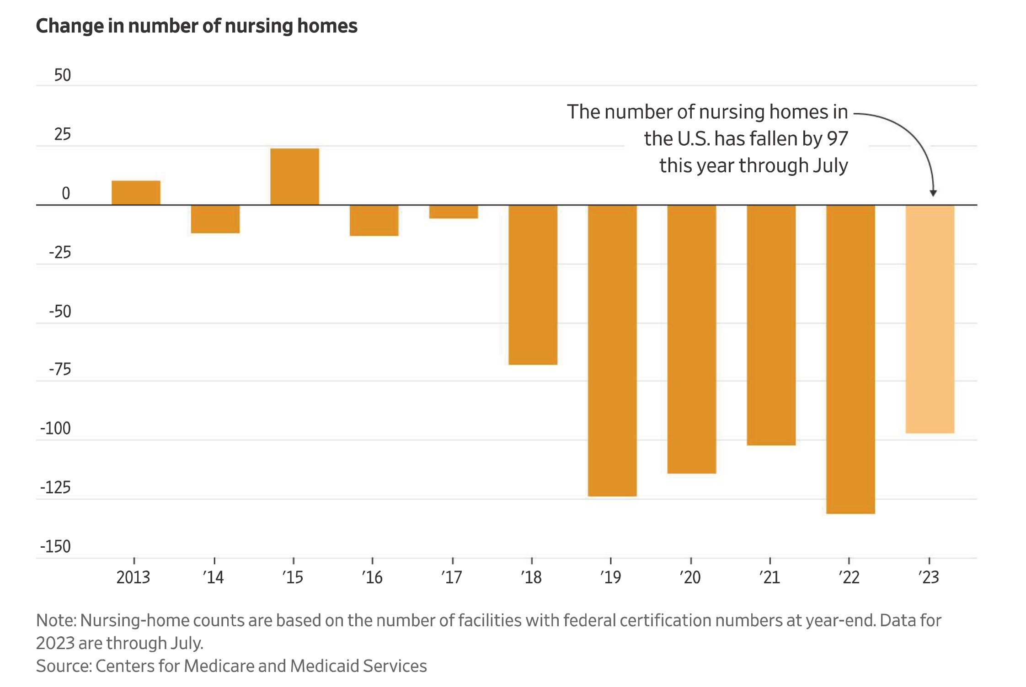
Are Nursing Homes Disappearing?

Slide 4
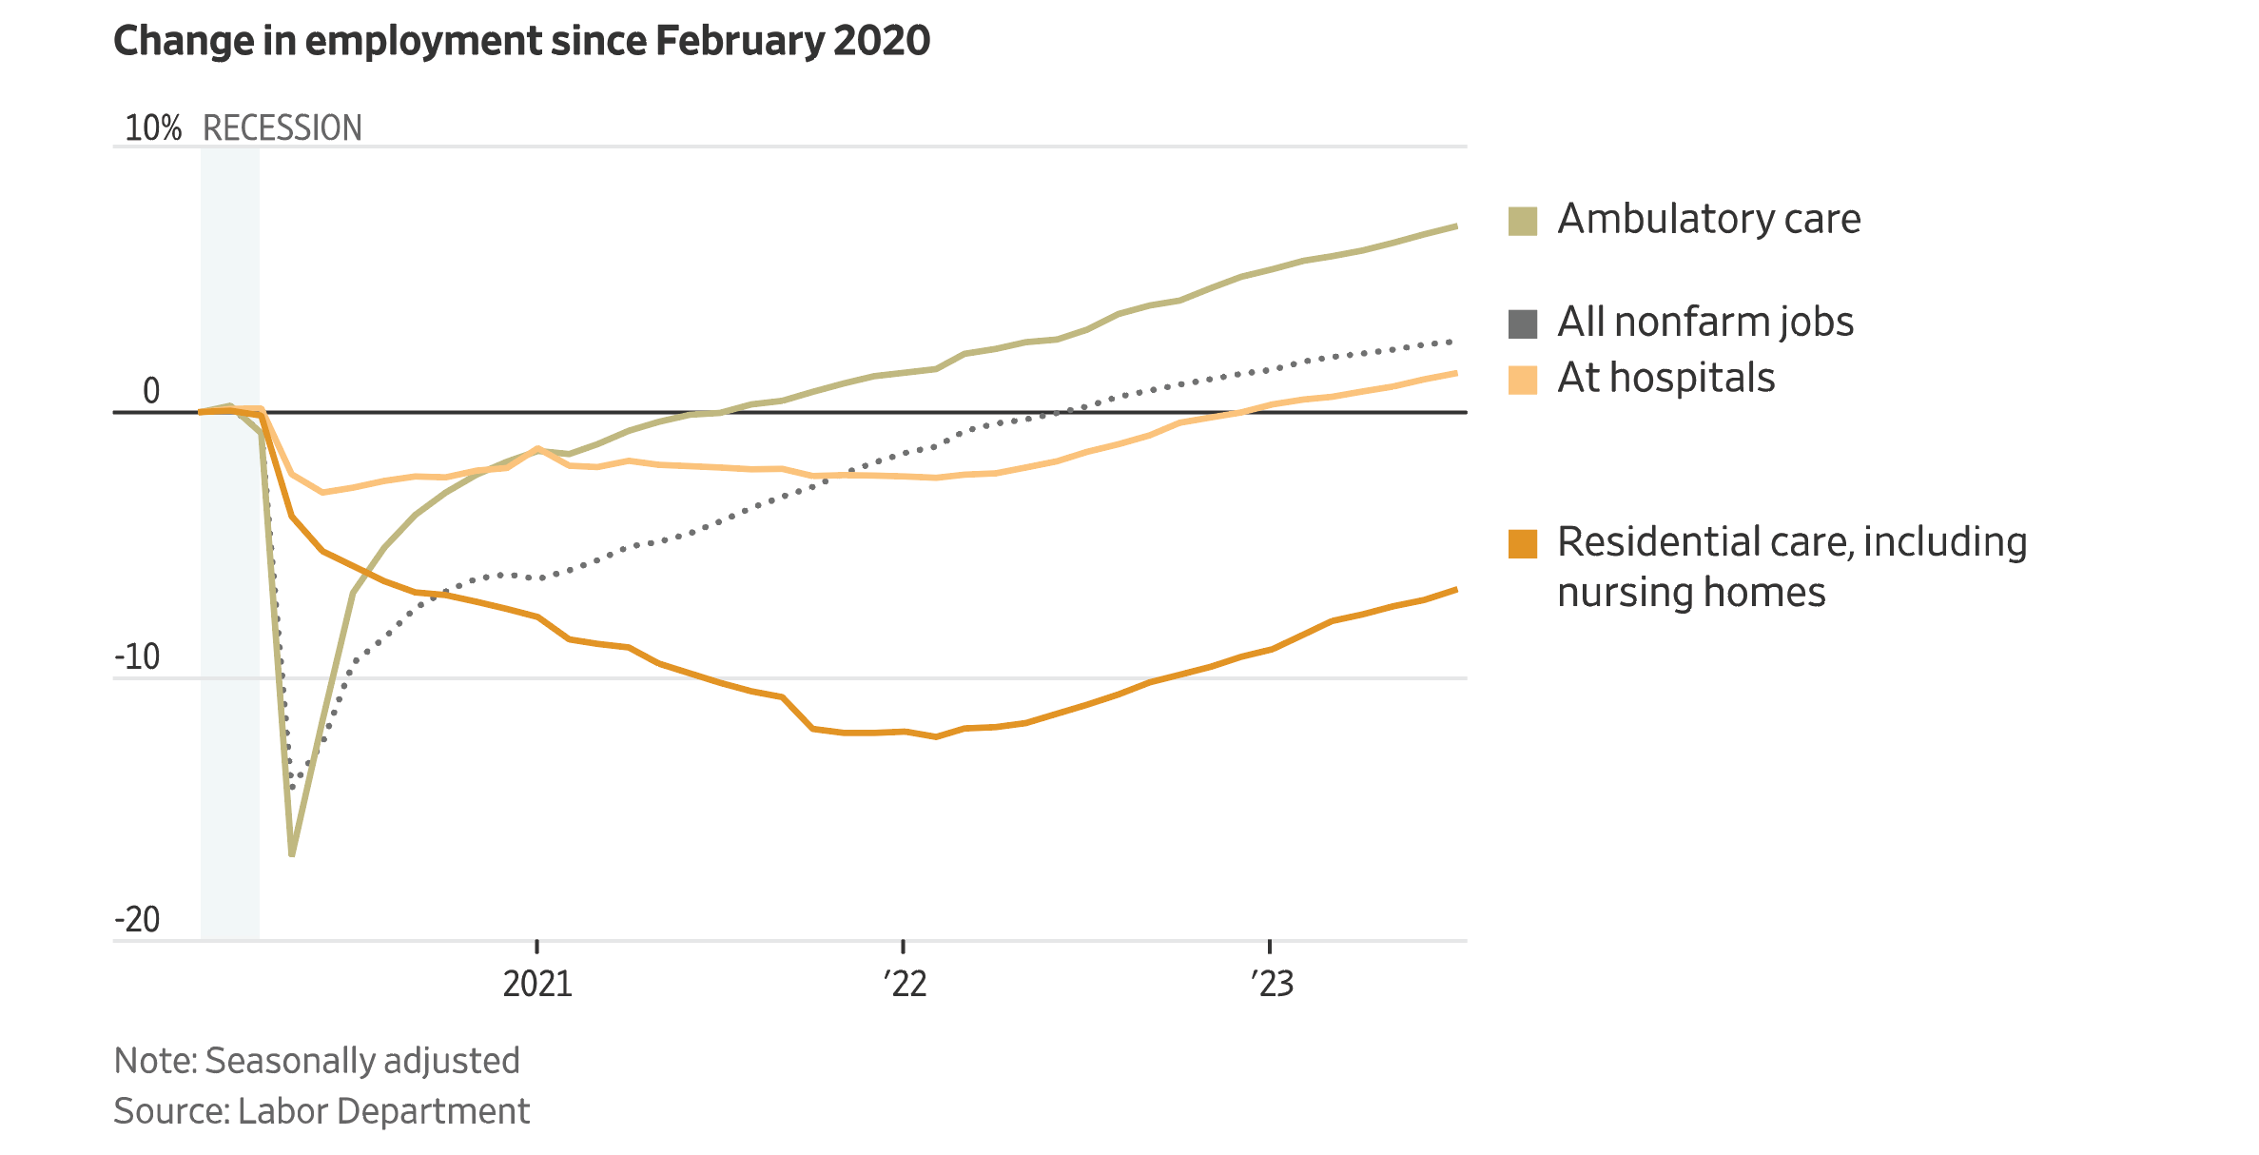
Change in Employment Since Pandemic

Slide 5
Pennsylvania Numbers Reflect NATIONAL TREND
10% drop in number of beds
13% drop in workforce
Rural Communities Impacted

Slide 6
New Federal Staffing Rule
3.48 hours of nursing care per resident
.55 hours by a Registered Nurse
2.45 hours by Nurse’s Aides

Slide 7
New Federal Staffing Rule
Phase in of Rule from 2027 to 2028
Interim and Final Rule
Rural facilities have more time

Slide 8
New Federal Staffing Rule
60% of facilities can meet interim staffing rule
Fewer than 1 in 5 can meet final staffing rule
Almost all facilities need to hire more staff

Slide 9
Pennsylvania’s New Staffing Requirements
2.87 Staffing hours per resident
Increasing in 2024 to 3.2 hours
Staffing for CNAs and LPNs

Slide 10
Final CMS Rule on Nursing Home Ownership
Educate residents
about ownership
Study to see if ownership affects care

Slide 11
Proposed Appeals Process for OBSERVATION STATUS
Switching from Medicare A to B
Affects coverage for skilled NH care

Slide 12
CMS “Jimmo” Settlement Reminders
Maintenance Coverage Standard
Maintain, prevent or slow deterioration

Slide 15
Carl
LEWIS

Slide 16
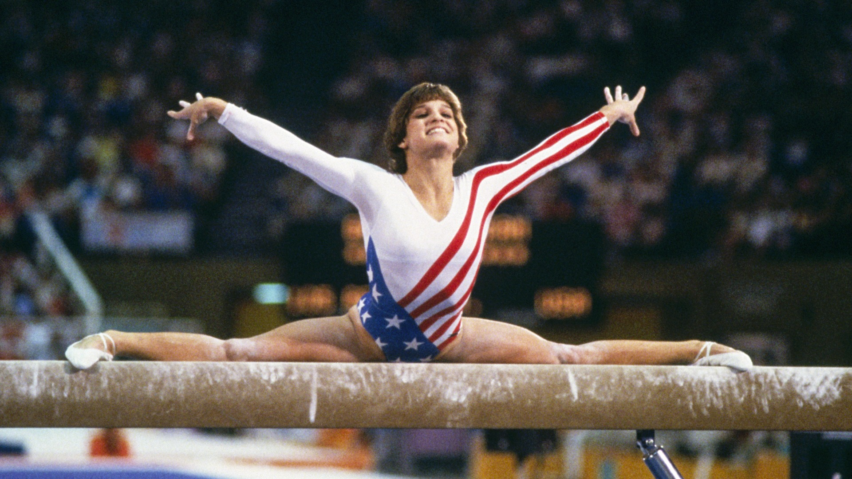
Mary Lou
RETTON

Slide 17
Zola Budd
&
Mary Decker

Slide 18
Expansion of Medicare EXTRA HELP PROGRAM
Low Income Subsidy Program
135% of Federal Poverty Level to 150%

Slide 19
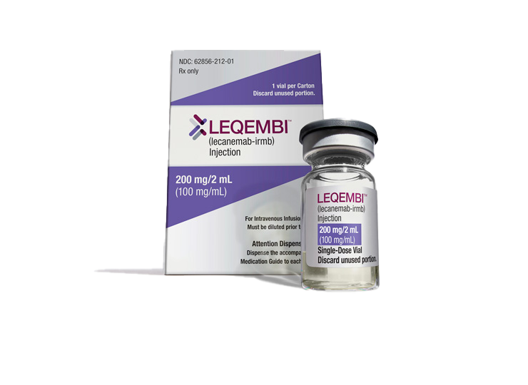
Experimental Alzheimer’s Drug Leqembi
First drug to slow progression
Targets amyloid plaques
Covered by Medicare

Slide 20
Change to Supplemental Security Income
Food no longer covered
In kind support and maintenance

Slide 21
Proposed Streamline of Application Process for SSI
Online application
Less documents
No in person meeting

Slide 22
Change how SSA Handles OVERPAYMENTS
Limit 10%
per check
Five year payment plan
Can request
a waiver

Slide 23
Stars at Summer Olympics
“Flo Jo”
Griffith Joyner

Slide 24
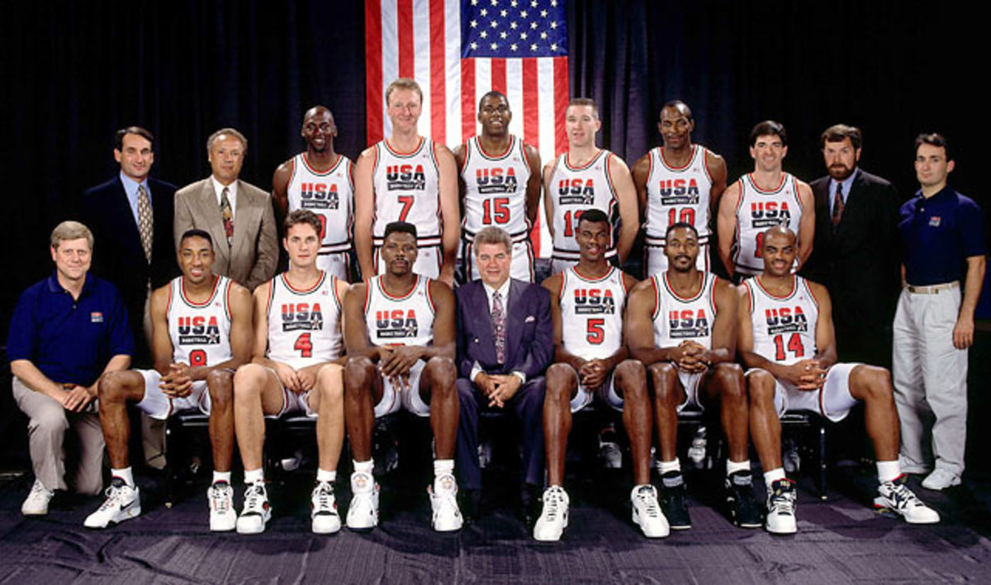
1992
DREAM TEAM

Slide 25
Usain
BOLT

Slide 26
Michael
PHELPS

Slide 27
SIMONE
BILES

Slide 28
AAA Issues Draft of “Aging our Way”
Unlocking Access
Aging in the Community
Gateways to Community
Caregiver Supports
Education and Navigation

Slide 29
Payments for Parents as Home Health Aides
Extension of PHE Waiver
Qualified parent or legally
responsible relative

Slide 30
Changes to Property Tax and Rent Rebate Program
Increase maximum rebate: $650 to $1000
Maximum household income of $45,000
Now tied to cost of living

Slide 31
New Guardianship Provisions
Appointment of counsel
Certification required for multiple guardianships
Focus on less restrictive alternatives

Slide 32
Compassionate Aid in Dying Bill
10 states currently
Pennsylvania House Bill 543
Tracks Oregon Death with Dignity Act

Slide 33
Olympic
CONTROVERSIES

Slide 34
Centennial Park
Bombing

Slide 35
Marion
JONES

Slide 36
Ryan
LOCHTE

Slide 37
IRS Letter Ruling for Some Irrevocable Grantor Trusts
To get a step-up in tax basis
Assets must be included
in gross taxable estate

Slide 38
FDIC Issues New Rules for Trust Accounts
$250,000 per beneficiary, up to $1,250,000
Revocable and Irrevocable
Doubles if two settlors/grantors

Slide 39
Surveys on Drafting Wills
Primary reason “lack of assets”
Cost of inflation?
Less than half of Pennsylvanians

Slide 41
SKATEBOARDING

Slide 42
BREAKDANCING

Slide 43
What to Watch
at the Olympics

Slide 44
Thank You for
Attending!

